Slide 1



Slide 2


Slide 3
Hey Cortana, Where Am I?
Danny Warren
@dannydwarren
dannydwarren@gmail.com

Slide 4
About Danny & InterKnowlogy
InterKnowlogy (www.interknowlogy.com)
15 year old services firm – Custom Application Development
Focused on building NUI solutions
Windows Universal Platform (Desktop, Tablet, Phone), Xamarin, WPF, Kinect, Azure
Touch, Gestures (Touchless), & Mouse and Keyboard
Formal R&D program: RECESS
Self guided learning/My time to prepare this presentation
Danny Warren, Sr. Software Engineer
Graduate Neumont University 2009, B.S. C.S.
Microsoft MVP in Windows Platform Development
Since Oct 2013
Former Nokia Champion
Avid Mt. Biker and aspiring Rock Climber

Slide 5
Location

Slide 6
Single Shot Location
Geolocator.DesiredAccuracy
Uses
Check-In’s
Placing a geocache
Where am I?
Where did I park?
What country am I in?

Slide 7
Continuous Tracking
Report Interval
Movement Interval
Uses
Running
Mt. Biking
Exercising
Navigation

Slide 8
Best Practices
Use Geolocator.StatusChanged to provide progress feedback to the user
Consider Battery Life
Personally Identifiable Information
Oh, Behave!!!

Slide 9
Cortana

Slide 10
UWP Cortana (Speech) API
Voice Commands
VCD.xml file
Used to launch Apps (Deep Link)
Used to display information provided by VoiceCommandService
Speech Recognition
Text-To-Speech (TTS)

Slide 11
Voice Commands
Create VCD.xml File
Register VCD File
Update Phrase Lists
Declare Dictation Phrase Topics
Declare Capabilities in Package.appxmanifest
Microphone
Internet

Slide 12
Text-To-Speech (TTS)
SpeechSynthesizer
. SynthesizeTextToStreamAsync(“normal language string”);
. SynthesizeSsmlToStreamAsync(“ssml string”);
Literally stick words in the phone’s mouth!

Slide 13
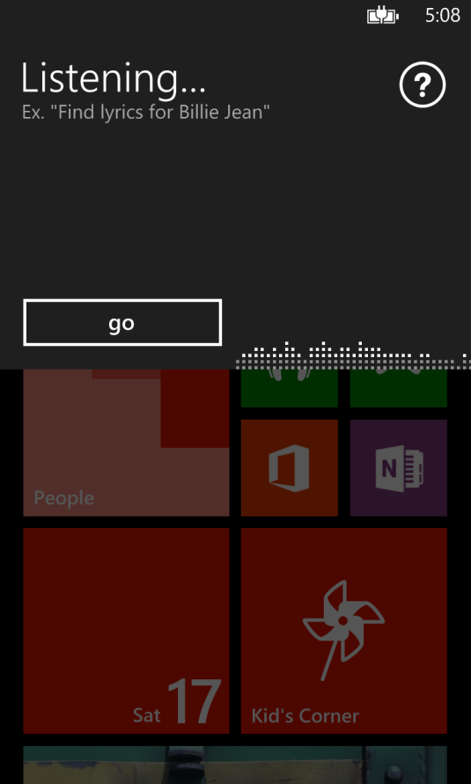
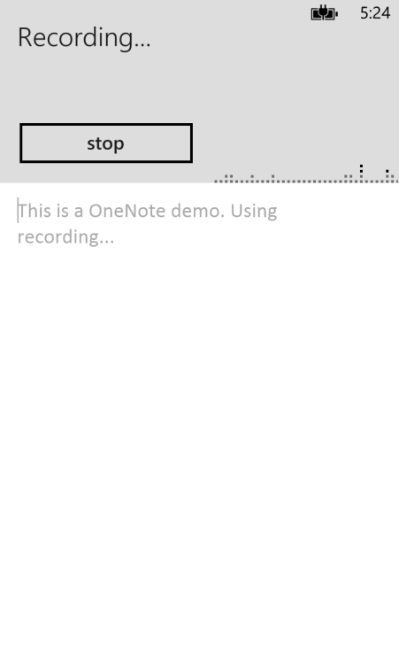
Speech Recognizers
SpeechRecognizer. RecognizeWithUIAsync()
SpeechRecognizer. RecognizeAsync()
Uses built in Speech UI
App must provide any desired UI for interaction

Slide 14
Using SpeechRecognizer
var speechRecognizer = new SpeechRecognizer( Windows.Globalization.Language )
speechRecognizer.Constraints.Add(commandConstraint)
Optional to add constraints
await speechRecognizerCaptainsLogCommand.CompileConstraintsAsync()
Even if no constraints were added
SpeechRecognitionResult result =
await speechRecognizerCaptainsLogCommand.RecognizeAsync()
Or RecognizeWithUIAsync
if ( dictationResult.Status == SpeechRecognitionResultStatus.Success
&& dictationResult.Confidence == SpeechRecognitionConfidence.Rejected
{
result.Text
}

Slide 15
Choosing a ISpeechRecognitionConstraint
SpeechRecognitionTopicConstraint(
SpeechRecognitionScenario.Dictation, “TopicHint”, “Tag" )
SpeechRecognitionScenario options
Dictation
FormFilling
WebSearch
SpeechRecognitionListConstraint( new[] { "1", "2" } )
Created in code from a list of strings
Extremely light weight, fast, and accurate
SpeechRecognitionGrammarFileConstraint ( [SRGS File] )
“[Can] capture multiple semantic meanings in a single recognition”
Industry Standard (meaning portable to other platforms)

Slide 16
Sample SSML (Speech Synthesis Markup Language)
string ssml =
@"<speak version='1.0' " +
"xmlns='http://www.w3.org/2001/10/synthesis' xml:lang='en-US'>" +
"Hello <prosody contour='(0%,+80Hz) (10%,+80%) (40%,+80Hz)'>World</prosody> " +
"<break time='500ms' />" +
"Goodbye <prosody rate='slow' contour='(0%,+20Hz) (10%,+30%) (40%,+10Hz)'>World</prosody>" +
"</speak>";

Slide 17
Download Materials
http://blogs.interknowlogy.com/author/dannywarren/
https://github.com/dannydwarren/Cortana-Location-UWP
Interested in talking more?
Contact Me
dannyw@interknowlogy.com
Mention That Conference

